Slide 1

Design of Test Automation Framework
BIRLA INSTITITUE OF TECHNOLOGY & SCIENCE PILANI (RAJASTHAN)
April 2023
SS ZG628T -BITS DISSERTATION
By
SAQUIB 2021MT1266

Slide 2
Agenda
Introduction
Background
Problem Statement
Objective
Overview of Design
Page Object Model Design
High Level Design
Tool and Library Used
Implementation & Working
Architecture design
Code Snippet
Demo of working Code
Report , Result & Discussions
Result Discussions
Allure Report
Future Scope and Limitation

Slide 3
Introduction
Background:
Customer frequently ask for complicated logic to be implemented.
As the consumer expectations changing in turn increase in complexity of the software application
The complexity of software system is making manual testing increasingly time-consuming, inaccurate, and ineffective, manual testing is not appropriate for essential and sophisticated applications.
Hence, Software test automation demand growing it expedites the testing process and ensures that deliverables are made on schedule
The scripts can be modified as needed and then reused with every new improvement
Automation testing increase coverage, quality, and help in quick delivery of product.

Slide 4
Introduction
Problem Statement :
There is not a single framework either paid or free available in the market which fulfill all the automation requirement, be it backend or frontend services, some are keyword driven few are data driven, some provide either recording facility or reporting facility only. Hence, we decided to implement hybrid, robust, reusable, stable, and consistent framework having good reporting and logging features available.
In this dissertation report we created Hybrid Design Page Object Model based Python Selenium test automation framework with the intention of increasing the effectiveness and efficiency of software testing.

Slide 5
Introduction
Objective:
Objective:
Design page Object Mode (POM) based selenium Python automation framework.
Automate some basic scenarios like Login, Logout, Dashboard Verification etc.
Framework should be able to run Data Driven Test Cases (eg: Login with multiple data sets.)
Framework print logs to each action or important steps also save the log file log folder.
Framework support screenshot capture in case of failure and save the screenshot in screenshot folder.
Support reporting tool to generate summary of all test cases pass/fail after the test suite run.
Integrate with build tool to run the automated and schedule job based on merge or check in trigger.

Slide 6
Overview of Design
Page Object Model :
An object repository is created in this POM model. It is independent of test cases and can be reused for a different project.
The naming convention of methods is very easy, understandable and more realistic.
Under the Page object model, we create page classes that can be reused in another project.
The Page object model is easy for the developed framework due to its several advantages.
In this model, separate classes are created for different pages of a web application like login page, the home page, employee detail page, change password page, etc.
If there is any change in any element of a website then we only need to make changes in one class, and not in all classes.
The script designed is more reusable, readable and maintainable in the page object model approach. Its project structure is quite easy and understandable

Slide 7
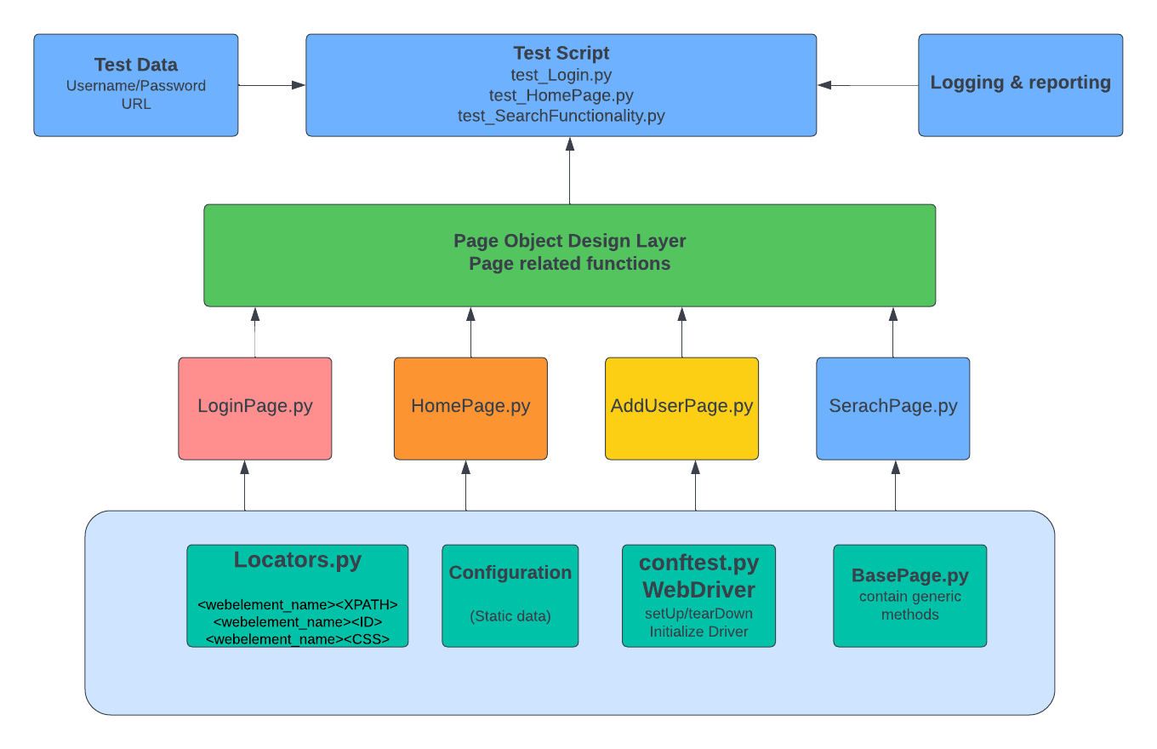
Overview of Design
High Level Design :
Fig 1. Framework
High Level Design

Slide 8
Tool and Library Used
This framework will use open-source components like selenium library and python scripting,
Using Pycharm editor tool to create and manage all code and execute throughout the dissertation project.
First step to create a new Project in Pycharm (STAF Framework Design) and install the dependent library.
Selenium: Selenium Libraies
Pyest: Python UnitTest Framework
Pytest-html: Pyest Html Report
Openpyxl: Run test parallel.
Allure-pytest: to generate allure reports
Nex step to create a Project folder structure in Pycharm (STAF Framework Design) and start coding the respective modules.

Slide 9
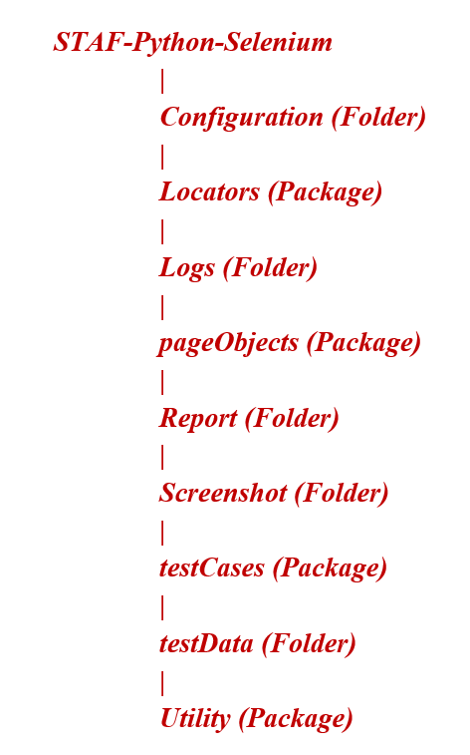
Project Structure in IDE
Fig 2. PyCharm Project Structure Directory.

Slide 10
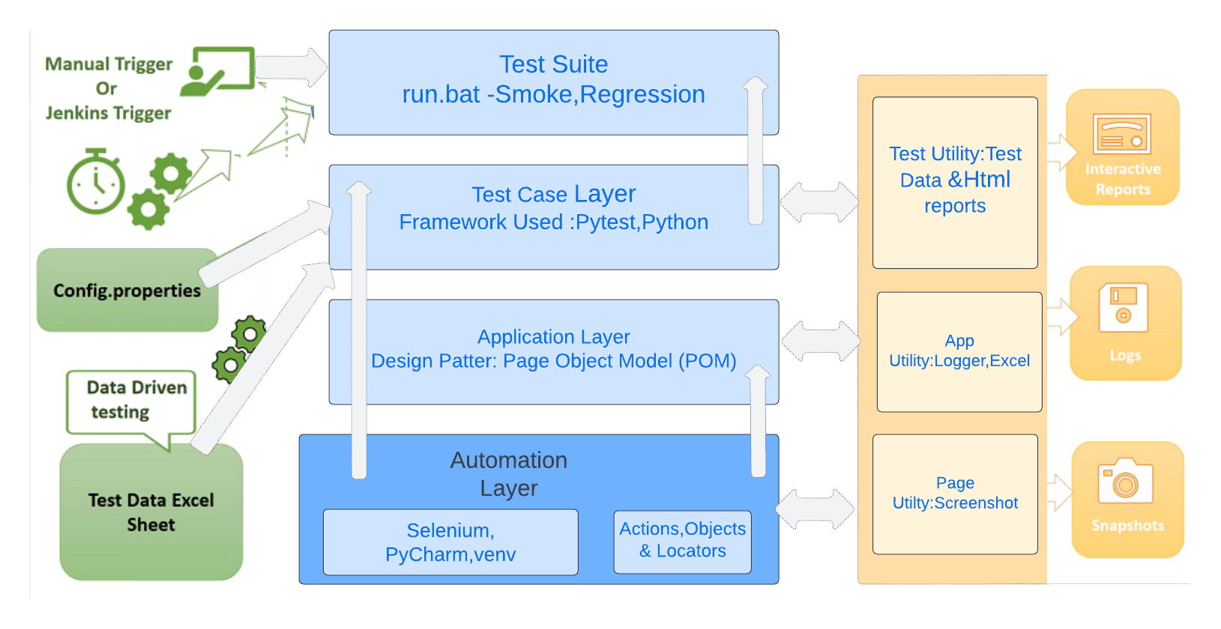
Implementation & Working
Fig 3. Architecture Diagram

Slide 11
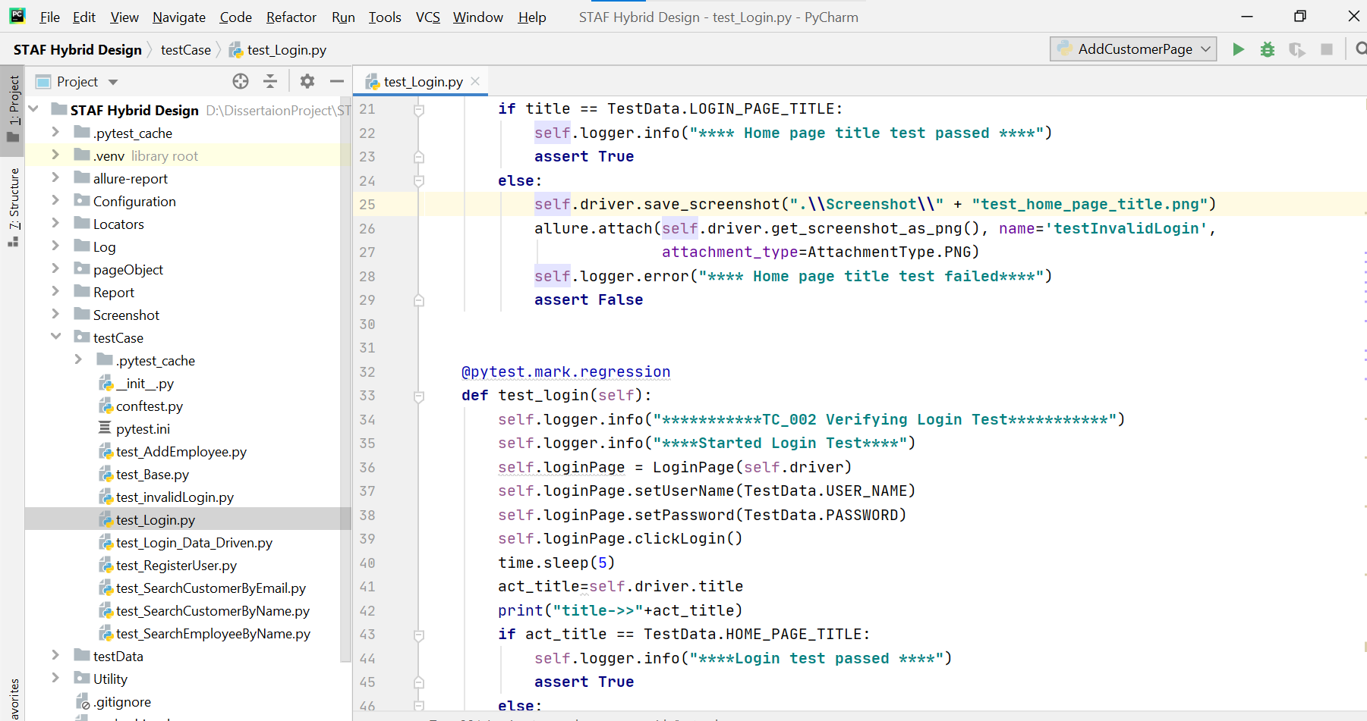
Code Snippet
Fig 4: Sample Login Script.

Slide 12
Demo of Working Code
Fig 7: Video Demo of the sample code working.
https://drive.google.com/file/d/1TCwwXHDGQ_1azJ94cnr4UoVEUlJDGo3V/view?usp=sharing

Slide 13
Report, Result & Discussions
Python integrated with pytets generate out of box html report but just providing one tag command at the time of execution of test cases.
These reports contains summary of test execution and Result of Pass and failed test cases.
Pytes-html reports are not much very intuitive and detailed, so we have generated allure report, Allure report are very informative and provide detailed description of the test run.
It can be also shared easily across the team, maintain the history of test run and percentage wise graphical dashboard
Along with report we enable logging feature in the framework, it keep the track of every steps executed during testing and help in debugging.
There is also provision to capture Screenshot of the failed test cases in the framework.

Slide 14
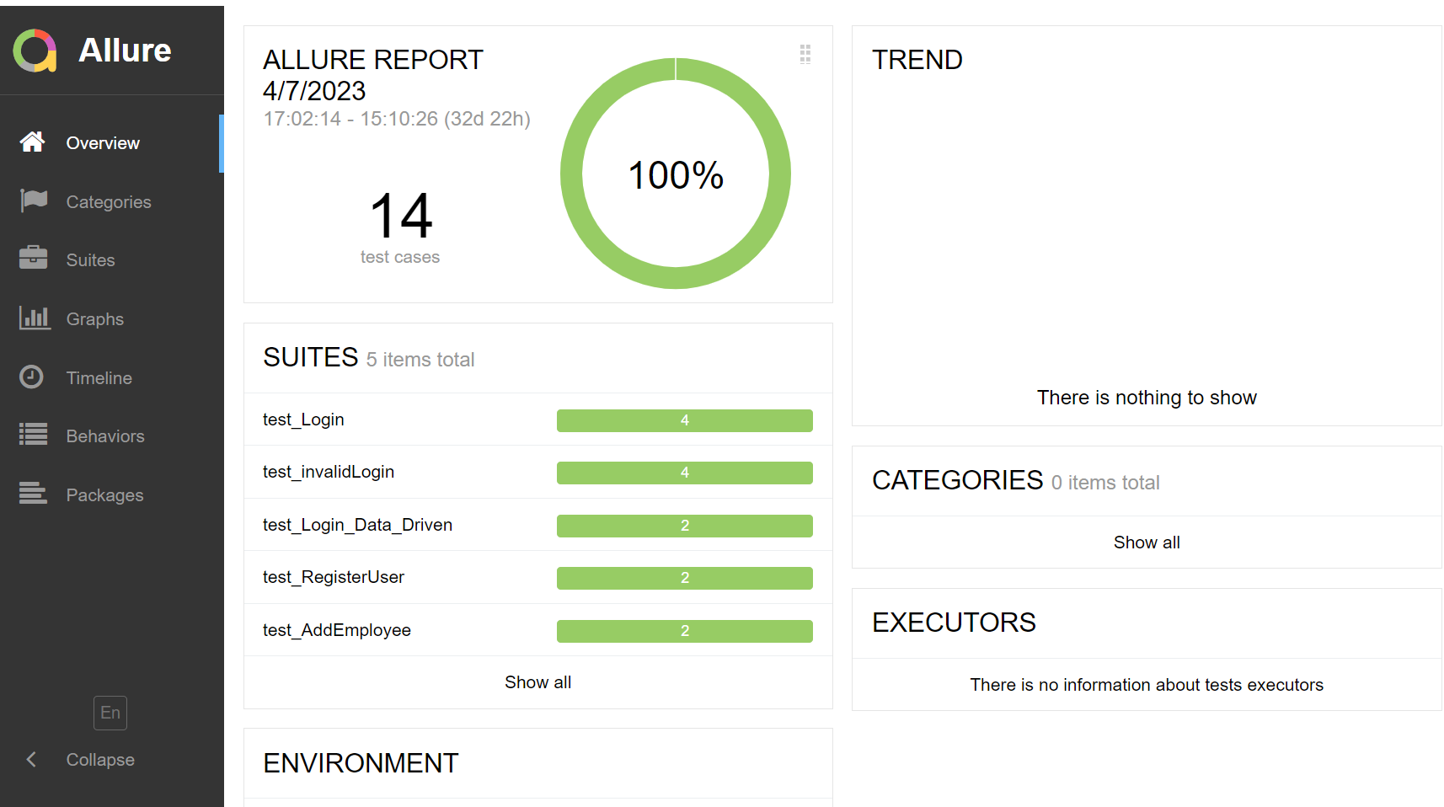
Allure Report Dashboard
Fig 8:Allure SummaryReport

Slide 15
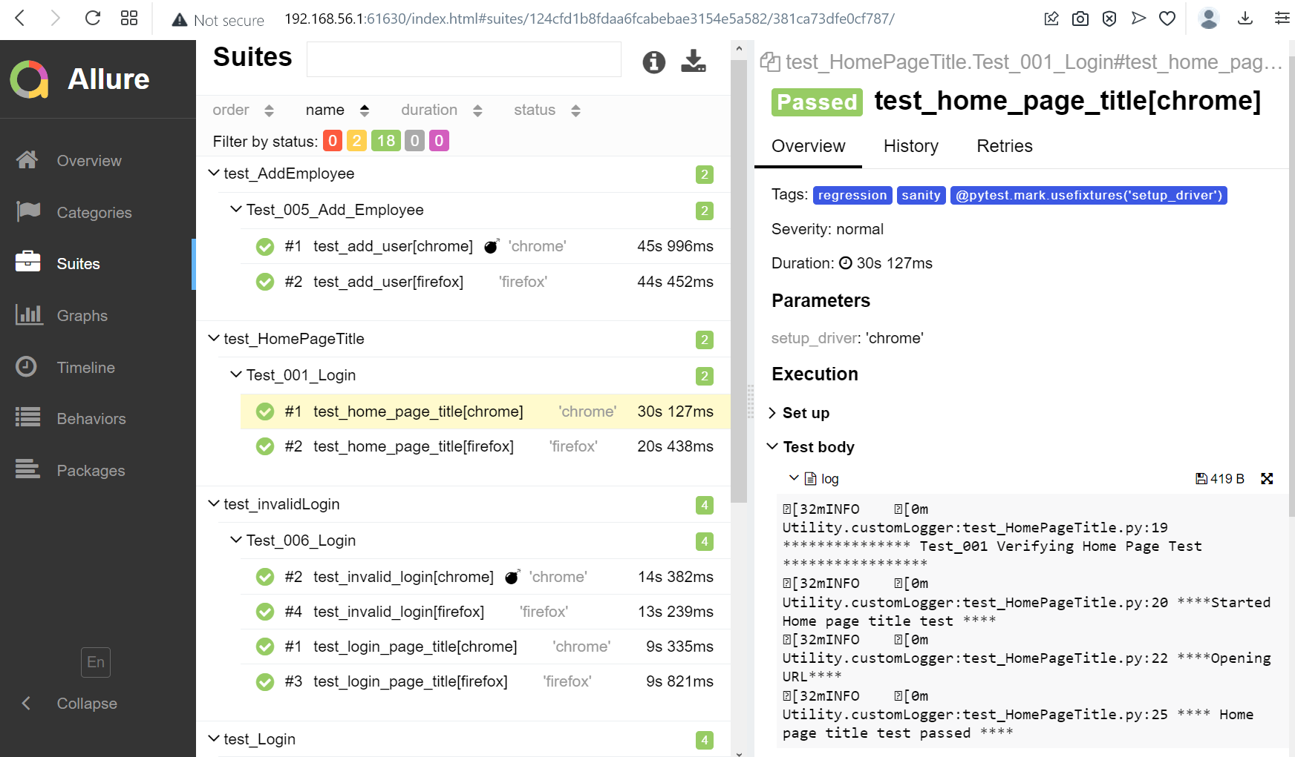
Allure Suite Report
Fig 9:Allure Suite Report

Slide 16
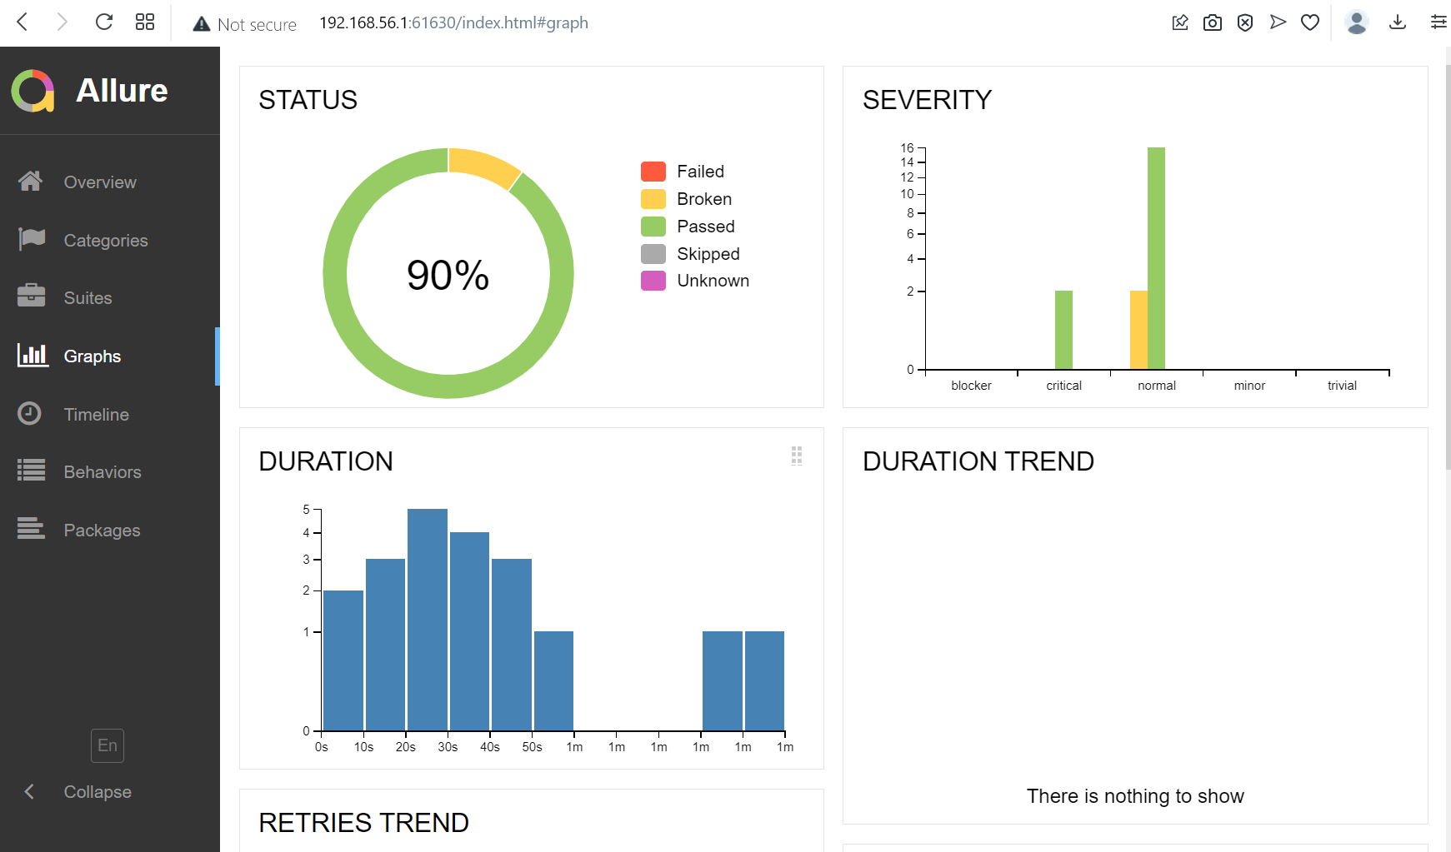
Allure Suite Report
Fig 10 :Allure Graph Report

Slide 17
Future Scope & Limitations
Future research could focus on optimizing the framework for larger or more complex web applications interconnected with multiple dependent system.
Framework designed can also be integrated with backend testing by installing request package and db connectors, used for backend api testing with less effort.
Future scope, Integration of framework with container docker and Kubernetes pods, use docker image to run test cases.
The automation framework presented in this dissertation report is a robust and scalable tool for automating web application testing.
. It provides a flexible and easy-to-use approach to testing that can be customized and extended to support a variety of web applications and test scenarios
Not suitable for automation of desktop-based application, not able to automate QR codes, captcha etc

